Slide 1

Mobile Device Usage and User Behavior Analysis Using Machine Learning in r programming
Tochukwu Aroh (A00025006)

Slide 2
2. Introduction
Background:
The widespread adoption of mobile devices has transformed user interaction with technology. Analyzing user behavior is essential for understanding preferences, optimizing services, and improving user experiences.
Importance of the Study:
Businesses can leverage insights from mobile usage data to tailor products and services. Machine learning offers powerful tools to identify patterns and predict user behavior effectively.
Objective of the Project:
Analyze mobile device usage data to classify user behavior into distinct categories using machine learning models. Deploy the best-performing model using an interactive Shiny application.

Slide 3
3. Problem Statement
Background:
The increased prevalence of mobile devices makes it essential to comprehend user behavior for enhancing user experiences and customizing services. Examining mobile device usage helps companies refine strategies by understanding user preferences and habits.
Problem Definition:
Challenge: Identifying patterns in large-scale mobile device usage data to improve customer engagement and service delivery.
Goal: Apply machine learning models to analyze user behavior and extract actionable insights.

Slide 4
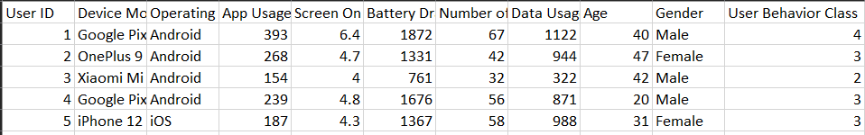
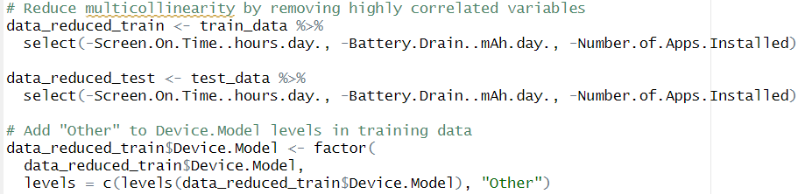
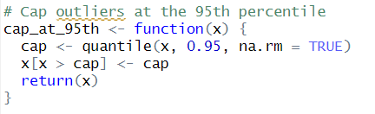
4.METHODOLOGY
4.1 Dataset Description
Mobile Device Usage Dataset from an open data platform (Kaggle).
Samples (Records): 700 and Features (Columns): 10
Features: Device Model, Operating System, Number of Apps Installed, Gender etc.
Target Feature: User Behavior Class – Light, Moderate, Heavy, Very Heavy, Extreme(1-5).
4.2 Data Preprocessing:
Handling Outliers: Outliers were capped at the 99th percentile to prevent extreme values from disproportionately influencing the models.
Reducing Multicollinearity: Reducing variables that highly correlated with each other

Slide 5
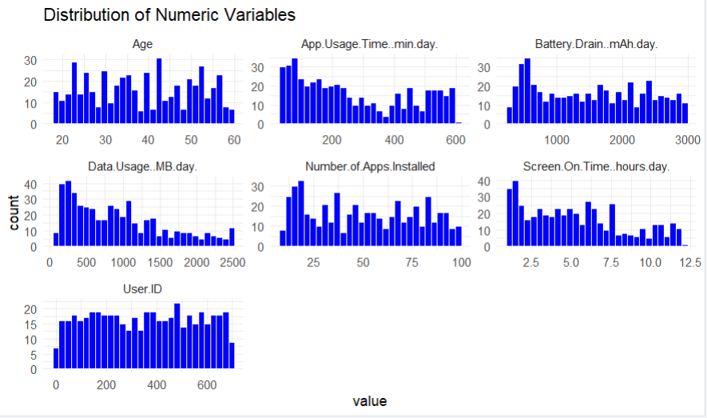
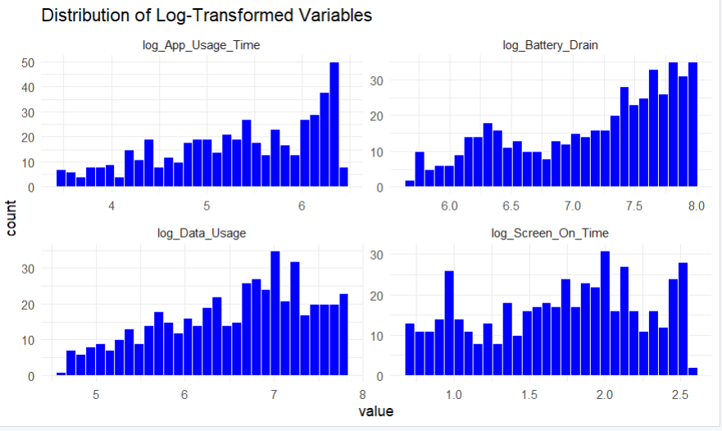
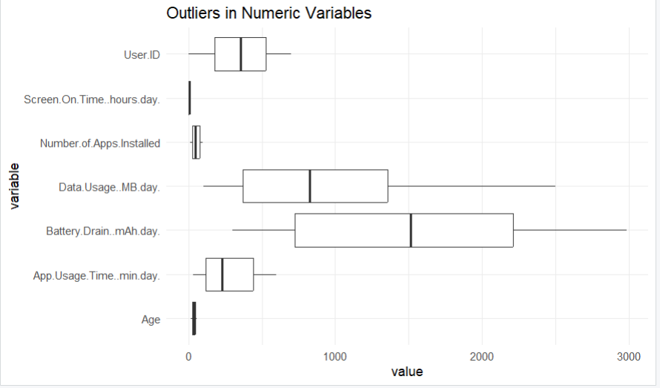
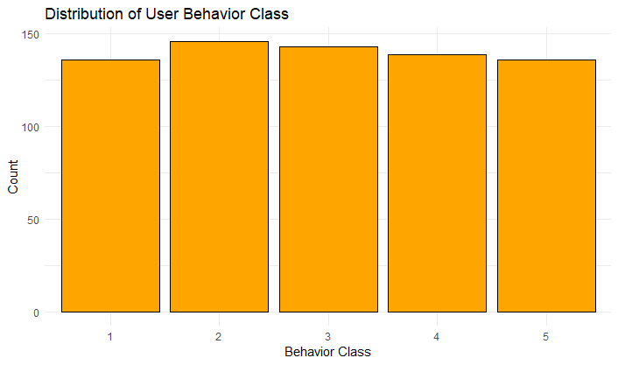
4.3 Exploratory Data Analysis (EDA) insights
Notes:
Challenges Identified:
Skewed data in key numerical features like data_usage and battery_drain.
Potential multicollinearity due to highly correlated variables Screen On Time and Battery Drain.
Significant outliers observed in features like data_usage (MB/day) and battery_drain (mAh/day).
Used one-hot encoding for variables like Device Model, Operating System, and Gender to convert them into numerical features.

Slide 6
4.4 Model Selection
Objective of Model Selection:
Identify machine learning models that balance interpretability, accuracy, and computational efficiency for analyzing mobile usage data.
Selected Models and Justifications:
Logistic Regression (LR):
Simple, interpretable, and provides insights into feature contributions.
Serves as a baseline to compare more complex models.
Support Vector Machine (SVM):
Handles non-linear relationships and overlapping classes effectively.
Consistently achieves high accuracy and recall.
Random Forest (RF):
Robust ensemble method that reduces overfitting.
Highlights feature importance and handles mixed data types well.
Why These Models?
Combines interpretability (Logistic Regression) with high performance (SVM and Random Forest).
Balances complexity, accuracy, and flexibility in model selection.
Logistic Regression
Random Forest
Support Vector Machine

Slide 7
4.5 IMPLEMENTATION
Tools and Libraries Used:
R and RStudio: Used for developing and testing the models.
Libraries:
Caret: Model training and evaluation.
GGplot2 and dplyr: Data visualization and manipulation.
Shiny: For deployment
Steps in Implementation:
Data Preparation:
Applied the preprocessing pipeline (log transformations, one-hot encoding, outlier capping, and feature selection).
Train-Test Split:
Split the dataset into training (80%) and testing (20%) sets.
Model Training:
Cross-validation done on each model for performance Logistic Regression, SVM and Random Forest.
Model Testing:
Evaluated models on the test set to ensure generalization performance.
Pipeline Automation:
Created reusable R scripts for preprocessing, training, evaluation and deployment for consistency.
Data Preprocessing
Train-Test Split
Model Training
Model Testing
Evaluation and Deployment

Slide 8
5. Experimentation and Evaluation
Training and Validation:
80/20 split with 5-fold cross-validation and hyperparameter tuning for LR, SVM, and RF.
Achieved 90.71% (LR), 95.71% (SVM), and 95.71% (RF) accuracy, with no overfitting validated through leakage checks.
Evaluation Metrics:
Accuracy: Correct predictions.
Recall: Ability to detect true positives.
Specificity: Ability to detect true negatives.
Precision: Percentage of predicted positives that are correct.
Baseline Comparison:
Baseline Accuracy of Random Classifier No Information Rate (NIR): 20.71%.
Improvement: +69% to +75% for all trained models.
Notes:
SVM and Random Forest demonstrated high generalisability and consistent performance.
Logistic Regression provided a strong baseline but lagged slightly in accuracy and class-specific metrics. Random classifier also mean guessing
The NIR is 20.71%.Your models achieve accuracies between 90.71% (LR) and 95.71% (SVM, RF), showing a substantial improvement over the baseline.

Slide 9
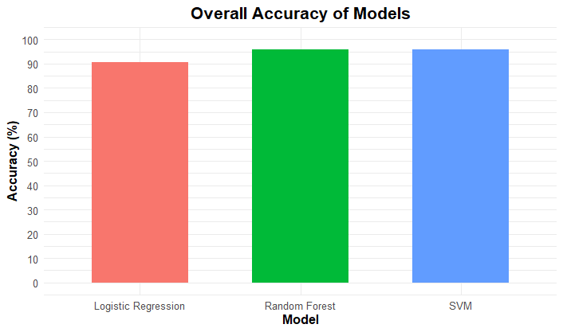
6. Results and Analysis
Model Performance
Overall Accuracy:
Logistic Regression: 90.71%
SVM: 95.71%
Random Forest: 95.71%
Class-Specific Recall (Sensitivity):
Logistic Regression: Struggles with Class 2 (82.14%) and Class 3 (82.14%).
SVM and Random Forest: High recall across all classes (≥92.86%).
Key Observations
Logistic Regression:
Simpler and interpretable but less accurate than SVM and RF.
Lower recall for Class 2 and Class 3 impacts performance.
Support Vector Machine (SVM):
Achieves consistent high accuracy and recall across all classes.
Precision is 90% or higher for all classes.
Random Forest:
Matches SVM in accuracy and recall.
Provides feature importance insights for interpretability.

Slide 10
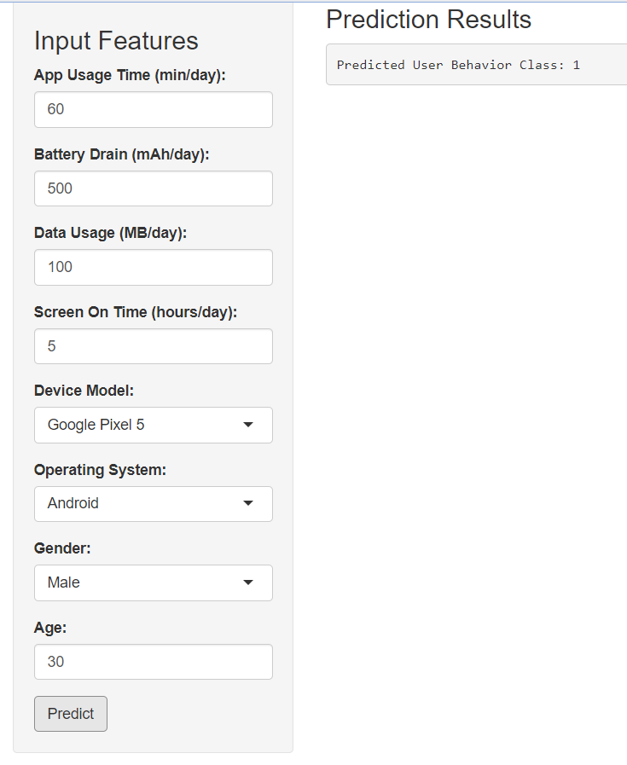
7. DEPLOYMENT
Deployment Objective:
To deploy mobile device usage behavior prediction model to the real world to help customer understanding and the use in production environment to bring impact to product developers and businesses.
Deployment Framework:
Offline deployment using Shiny provides an interactive, local interface without internet dependency.
Key Features:
Form-based input, prediction trigger, and immediate display of the user behaviour class.
Deployment Workflow:
Pre-trained Model -> Shiny App -> Prediction Output.
Why Offline Deployment?
Ideal for limited internet access and ensures data privacy with local computations.
Pre-trained Model
Shiny App
Prediction Output

Slide 11
7. Conclusion
Summary:
The analysis focused on mobile device usage and user behavior using Logistic Regression, Support Vector Machine (SVM), and Random Forest. Random Forest was selected for deployment due to its combination of high accuracy and interpretability.
Key Takeaways:
Balanced dataset and robust preprocessing contributed to high model performance.
Random Forest and SVM achieved high accuracy (95.71%), with Random Forest offering additional feature insights.
Challenges Encountered:
The small dataset limited generalizability.
Initial concerns about overfitting due to high accuracy were addressed through thorough validation strategies.
Future Work:
Expand the dataset to improve model generalizability.
Deploy the application online for broader accessibility.
Investigate advanced models that enhance both accuracy and interpretability.

Slide 12
References
Wickham, H., & Grolemund, G. (2017). R for Data Science: Import, Tidy, Transform, Visualize, and Model Data. O'Reilly Media.
W3Schools. (n.d.). R Programming Tutorial. Retrieved from https://www.w3schools.com/r/
Khorasani, V. (n.d.). Mobile Device Usage and User Behavior Dataset. Retrieved from https://www.kaggle.com/datasets/valakhorasani/mobile-device-usage-and-user-behavior-dataset

Slide 13
Thank you

